Slide 1
Elmer Imes
Elmer Samuel Imes (1883–1941)
Physics 9 Austin Horner
Ms Francois 2022-9-18

Slide 2
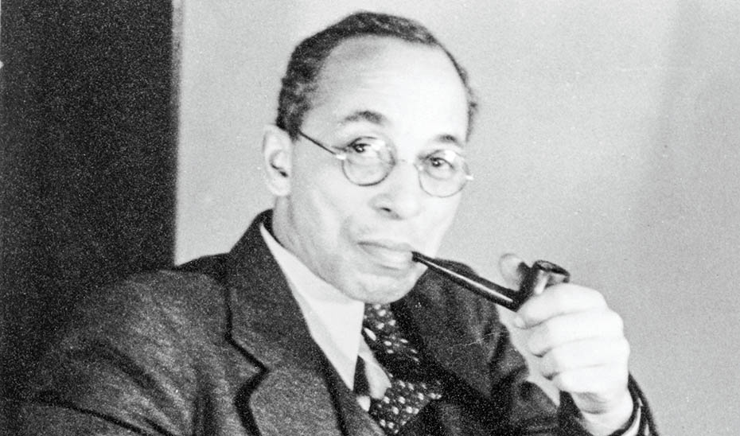
Figure 1. Elmer Samuel Imes (1883–1941). (Fisk University, John Hope and Aurelia E. Franklin Library, Special Collections; AIP Emilio Segrè Visual Archives.)
Notes:
Figure 1. Elmer Samuel Imes (1883–1941). (Fisk University, John Hope and Aurelia E. Franklin Library, Special Collections; AIP Emilio Segrè Visual Archives.)

Slide 3
Name of Individual, Birthplace, Date and Photos/Illustrations
Elmer Samuel Imes (1883–1941)
Birthplace: Memphis, Tennessee Birthdate: October 12, 1883
Father: Benjamin Imes, minister, Oberlin graduate, missionary
Mother: Elizabeth Wallace, former slave Oberlin graduate, missionary
Notes:
Figure 1. Elmer Samuel Imes (1883–1941). (Published by permission of Fisk University, John Hope and Aurelia E. Franklin Library, Special Collections; courtesy of the AIP Emilio Segrè Visual Archives.)

Slide 4
Education
Occupation
Elmer Imes earned a PhD in physics in 1918 from the University of Michigan.
He was only the second African-American to earn a doctorate in physics.
Elmer Imes was an experimental quantum physicist.
His PhD thesis, “Measurements on the Near-Infrared Absorption of Some Diatomic Gases,” was published in 1919 in the prestigious Astrophysical Journal.
He established Fisk University’s physics department.

Slide 5
Contributions to Science
caused a “a turning point in scientific thinking”
Elmer Imes was a pioneering developer of the field of quantum mechanics. Physicist Earle Plyer said that he caused a “turning point in scientific thinking” (Davis 2022) by demonstrating the practical application of quantum theory, previously considered exotic and theoretical. He used quantum science and light to measure and identify atomic structures.

Slide 6
Contributions to Science
Improved scientific instruments
With massive attention to the tiniest detail, Elmer Imes conducted pioneering experiments. Ultra-precise laser mirror angles and temperature control were critical. Imes created an impressive lab-sized apparatus to shine light through samples to see which frequencies were absorbed due to the quantum relationship of atomic rotation and vibration. His work fixed the fuzzy vision of spectrographic instruments of his day. Thanks to his research, scientists could detect the ultra-fine, quantum fingerprint of molecular substances, and deduce the composition of distant stars.

Slide 7
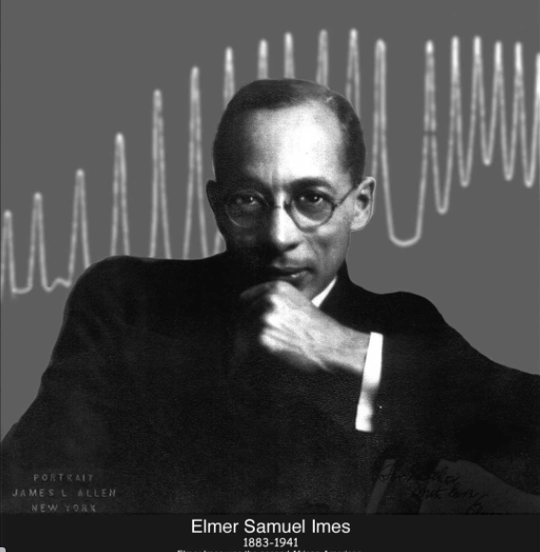
Fig. 2. Portrait of Elmer Imes by James L. Allen. University of Michigan physics

Slide 8
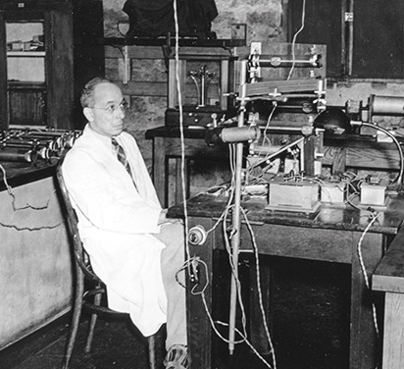
Fig. 3. Photo of Elmer Imes in his laboratory at Fisk University.
(In Mickens, Physics Today. Courtesy Fisk University, John Hope and Aurelia E. Franklin Library, Special Collections; courtesy of the AIP Emilio Segrè Visual Archives.)

Slide 9
Contributions to Science
“Shook the scientific world”
Imes co-authored a paper in Physical Review * with Harrison A. Randall that “shook the scientific world.” (Fikes 2022).
Titled, “The fine structure of the near infra-red absorption bands of HCI, HBr, and HF,” it was a breakthrough in studying materials at the atomic level. It was the first to measure the distance between atoms in molecules, and first to detect evidence of two chlorine isotopes.

Slide 10
Challenges this Individual Faced
Interesting or Unusual Facts
Racial discrimination, segregation
Elmer Imes was born in the era of the Civil War, when people of color were often considered property (Mickens 2018), not professionals. His mother was a former slave. Nevertheless, both his parents earned college degrees.
Later in life, Imes faced professional discrimination because of his race. He to moved New York in 1918 because it was more progressive. Despite segregation, he returned to the south in 1930 to establish the physics department at Fisk University in Tennessee.
Imes came from a distinguished African-American family with achievements in farm-ownership, business, science, and church ministry (Mickens 2018).
He was married to the author Nella Larson, and was connected with the intellectual and creative movement of the Harlem Renaissance.

Slide 11
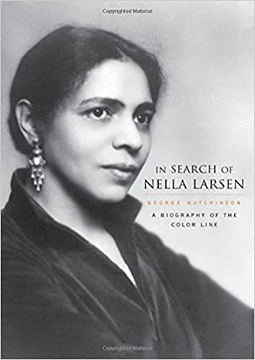
Fig 4. Book cover with an image of Nella Larson, leading Harlem Renaissance novelist, and wife (later divorced) of physicist Elmer Imes. She explored the situation of mixed race people, and wrote a mystery called The Passing about the different fates of two mixed-race women. One married a white racist, and the other married a black doctor. (In Search of Nella Larsen: a biography of the color line. George Hutchinson, Harvard University Press, 2006)

Slide 12
Sources
Works Cited
Davis, RM. “The work of Elmer Imes.” Symmetry Magazine, 27 January 2022, https://www.symmetrymagazine.org/article/the-work-of-elmer-imes. Accessed 18 September 2022.
Fikes, Robert. “Elmer Samuel Imes (1883-1941).” Blackpast, 7 November 2017, https://www.blackpast.org/african-american-history/imes-elmer-samuel-1883-1941/. Accessed 18 September 2022.
History.com editors. Harlem Renaissance - Definition, Artists & How It Started - HISTORY, 12 January 2022, https://www.history.com/topics/roaring-twenties/harlem-renaissance. Accessed 18 September 2022.
Mickens, Ronald E. “The life and work of Elmer Samuel Imes.” Physics Today, vol. 7, no. 10, 2018. Physics Today, https://physicstoday.scitation.org/doi/full/10.1063/PT.3.4042. Accessed 18 September 2022.
Shapiro, Maura. “Which Physicist Are You?” American Institute of Physics, 22 October 2021, https://www.aip.org/history-programs/niels-bohr-library/ex-libris-universum/which-physicist-are-you. Accessed 18 September 2022.

